Slide 1

Technology as the Medium, Setting, or Phenomenon
Janet Salmons, PhD

Slide 2
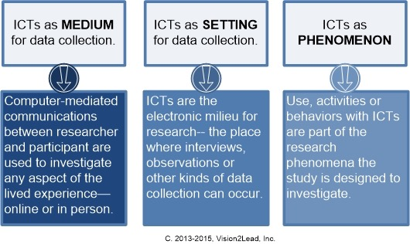
Communicating online for research purposes

Slide 3
Using ICTs as the Medium
Conduct online interviews with participants undergoing cancer treatment in five countries.
Discuss support they gain locally from family, friends, and community groups.

Slide 4
Using ICTs as the Setting
Choose as the setting a private online lung cancer support community, and gain permission from the group moderator. Analyze archived online threaded messages, links to online resources and related materials posted during a specific time frame.

Slide 5
Using ICTs as the Setting
Choose a web conferencing platform as setting photovoice interviews with cancer patients, because the features allow participants to share and discuss photographs of the people and places they associate with support and healing.

Slide 6
Studying ICTs as the Phenomenon
Choose three social networking sites and compare how self-identified cancer patients use the ICTs. How do the types of posts (length, level of personal exposure, use of images) compare between private groups or open discussions?

